Slide 1
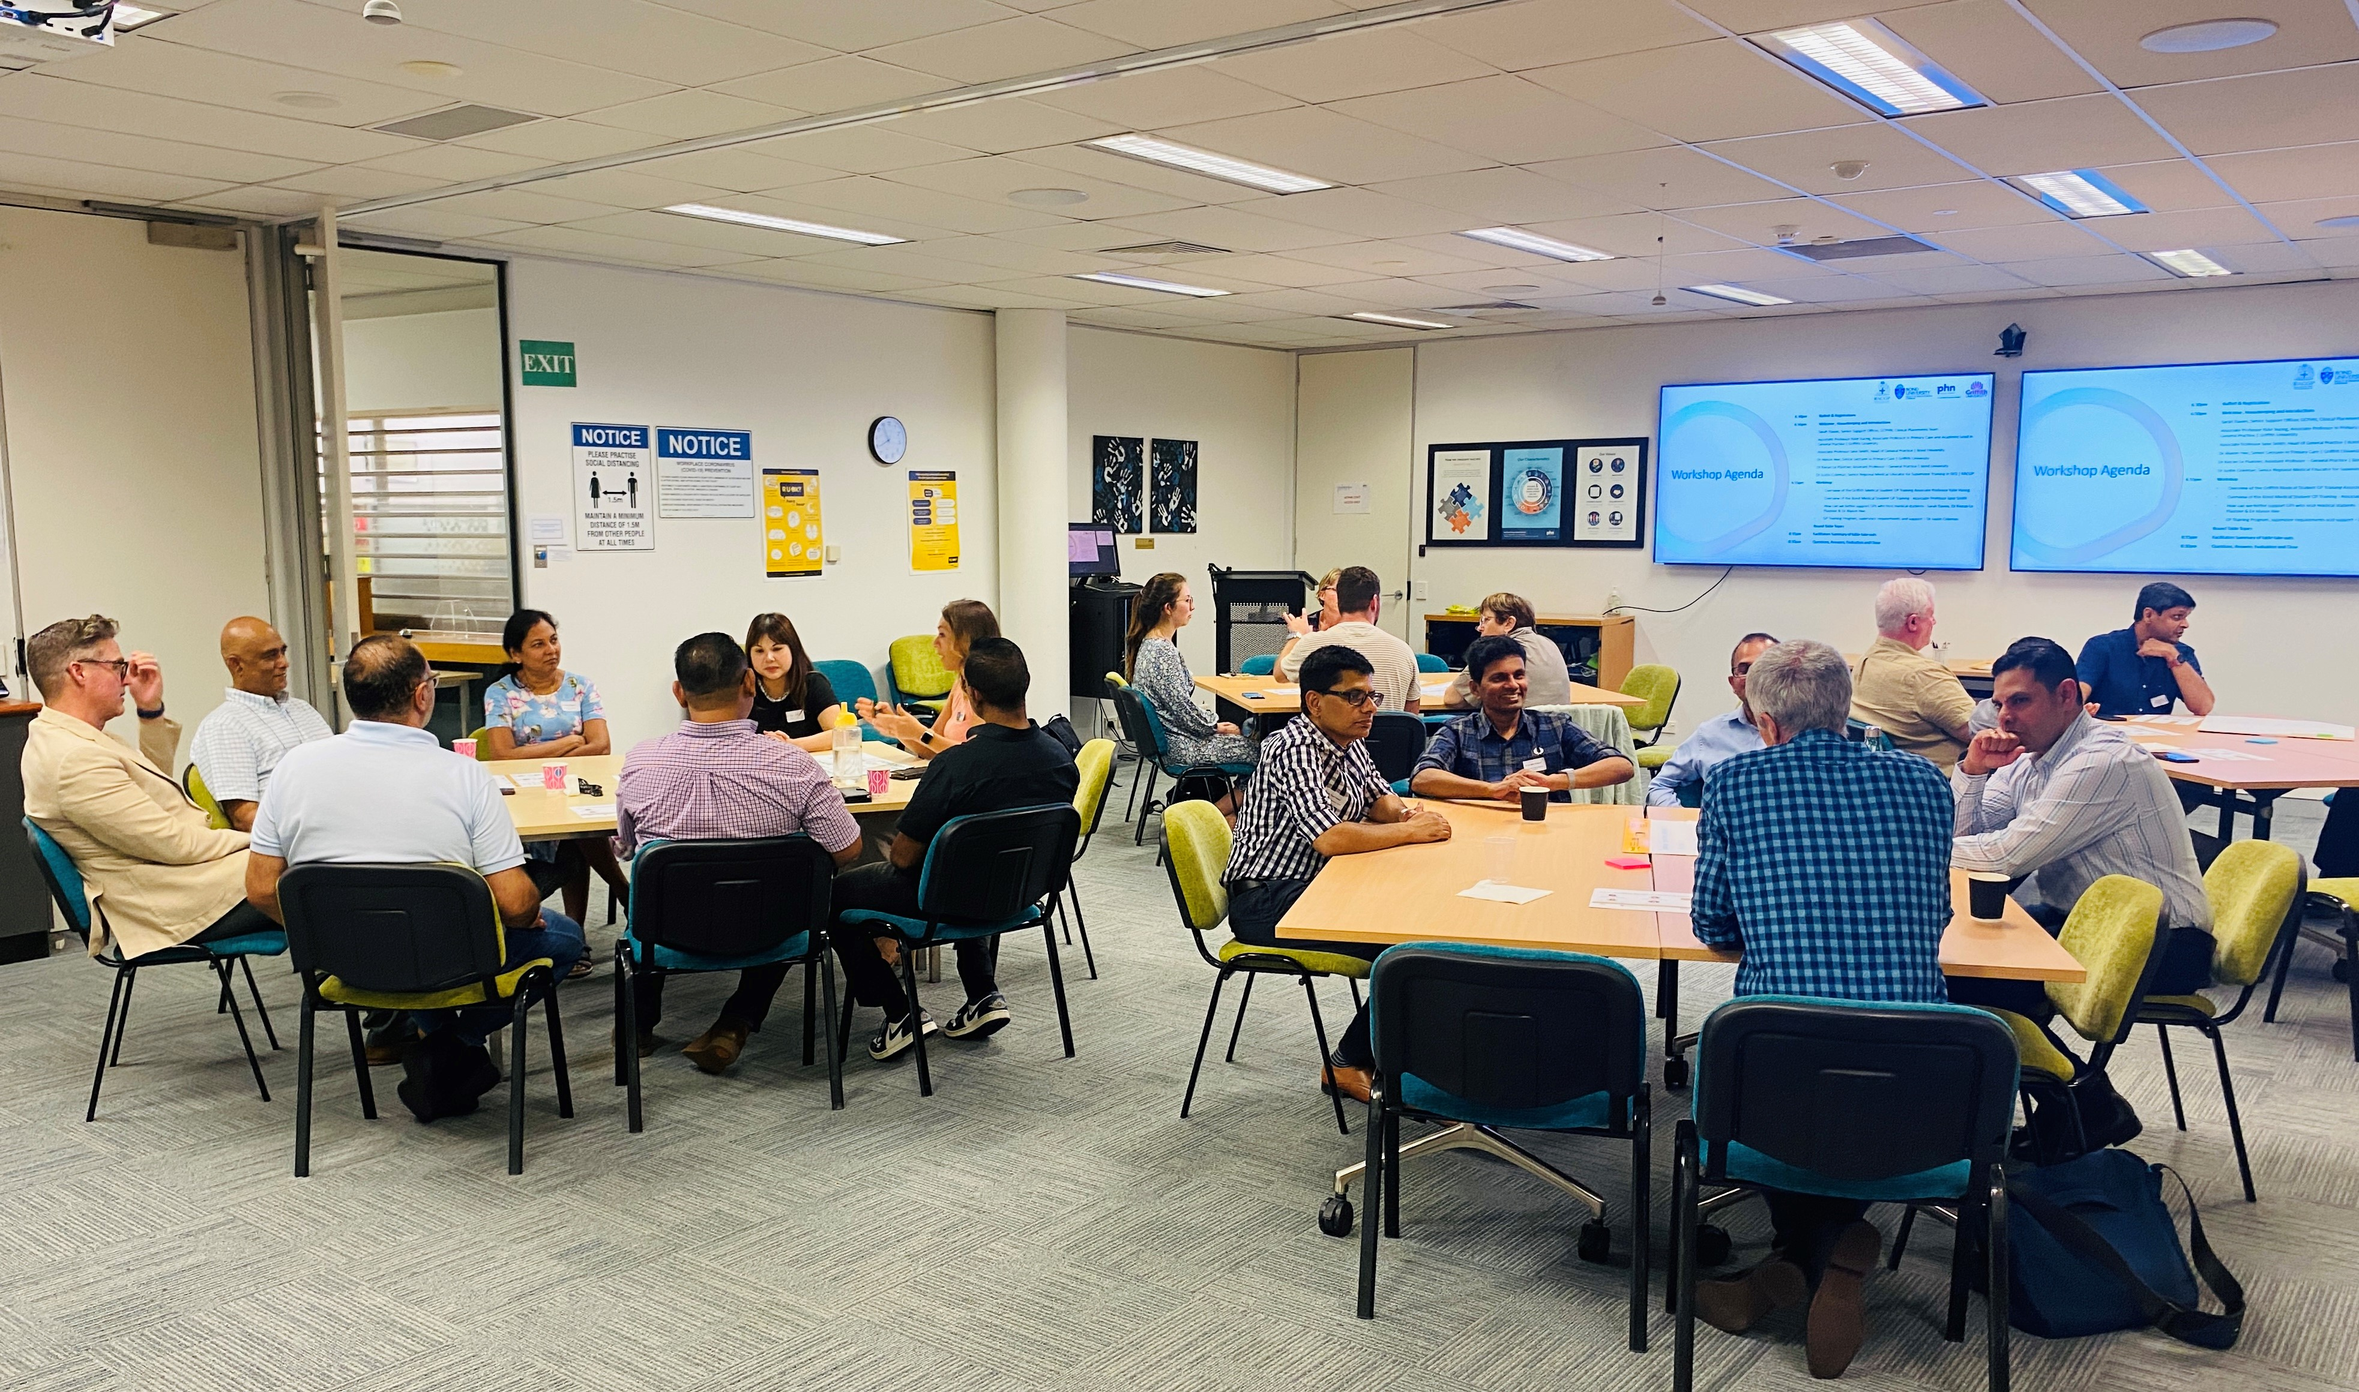
GP Trainer Workshop
12 March 2024
What was Covered & Knowledge Gained
Overview of the Bond University & Griffith University GP Medical Programs- Associate Professor Jane Smith & Associate Professor Kylie Vuong
GP Training Program - supervisor requirements and support – Justin Coleman
Introductory Clinical Placements-
These placements are for medical students in the first and second (Phase 1, Griffith University), or third (Bond University) years of study. For many students, this will be their first clinical placement.
The aim of the placement is to introduce students to clinical general practice with real patients and opportunities to apply their new skills. The expected outcome is for students to have a better understanding of the specialty of general practice in managing undifferentiated conditions, preventing disease, and promoting health.
Final Year Placements
These placements are for medical students in their final year of study. The aims of the placements are to provide students with more active opportunities to participate in the clinical general practice team under supervision. The desired outcome is for students to develop their clinical knowledge, skills, and competencies to become more effective interns at graduation.
We would like to inspire all students to consider general practice as a career choice.
94% of attendees stated that the event was Entirely Relevant to their organisation
How Can we Better Support GPs who Host Medical Students- Sarah Davies, Dr Kieran Le Plastrier & Dr Alyson Hee
Feedback
  Specifically the constructive student feedback and areas to improve on.
  University feedback from student surveys and informal student feedback
Better visibility of where each student is at with clinical exposure and learning.
Universities preparing and empowering the students to have open discussion with GPs around where they are at with learning and scheduling while on placement.
Hints and tips to drive student engagement and provide effective student feedback and coaching.

